Slide 1
Gesture Recognition Using Deep Learning
Malhar Patwari
A20410420
Herick Asmani
A20399752

Slide 2
Problem Statement
Control computer, Tv, other devices just by using hand!
Application in advanced driver assistance systems (ADASs)
Advancement in deep learning
Better approach than feature engineered Machine Learning models
Challenges:
Intra and inter-persons variations in hand gesture motion
Inter-person variations in the shape and size of the human hand
Illumination variations
Background noise

Slide 3
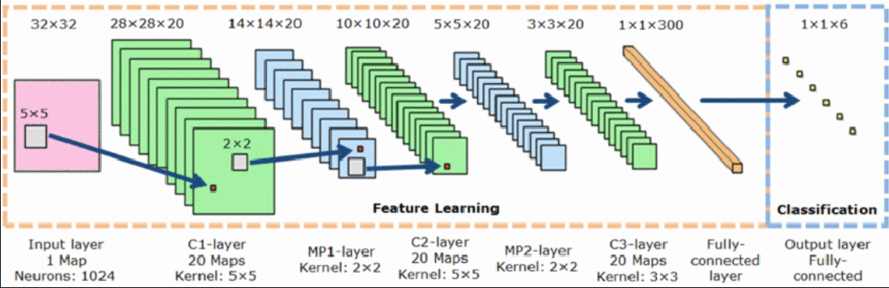
Background
2D Convolutional Neural Network

Slide 4
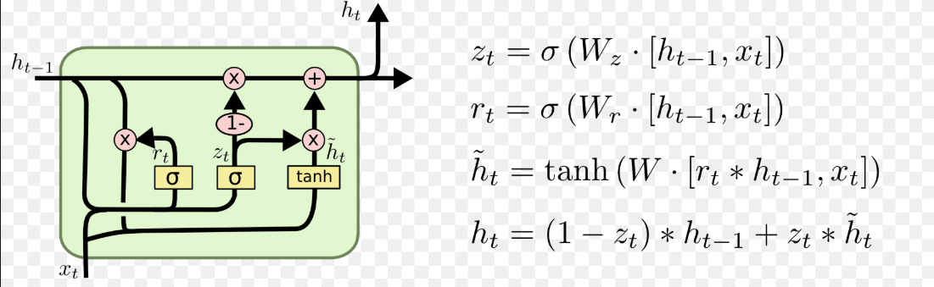
Background
Long Short Term Memory unit

Slide 5
Data
The dataset used for this project is Cambridge Hand Gesture Dataset. The data set consists of 900 image sequences of 9 gesture classes, which are defined by 3 primitive hand shapes and 3 primitive motions as shown in figure below.
Each class contains 100 image sequences (5 different illuminations x 10 arbitrary motions x 2 subjects).

Slide 6
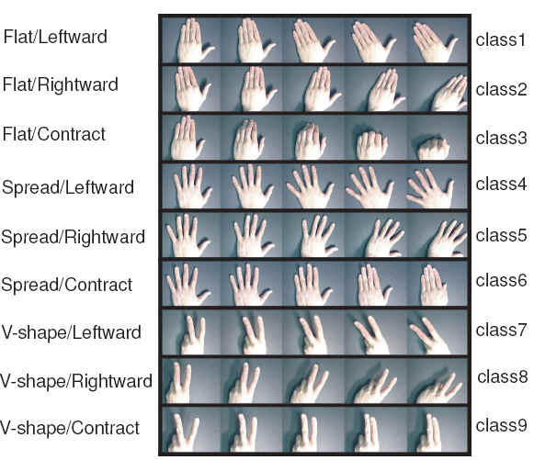
Data

Slide 7
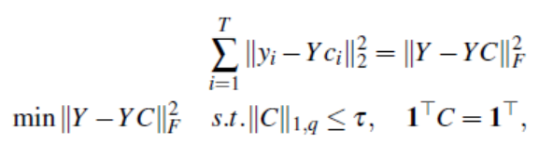
Proposed Solution
Step 1
Sparse Modeling Representative Frames (SMRF)
Extract representative frames of a video sequence
“See all by looking at a few: Sparse modeling for finding representative objects” by Ehsan Elhamifar , Guillermo Sapiro , René Vidal

Slide 8
Proposed Solution
Step 2
Preprocessing steps
One hot encoding of class labels
Normalize data by subtracting mean pixel value and divided by standard deviation
Shuffling data to reduce bias
Split data in to 700, 100, 100 videos for train, validation and test respectively

Slide 9
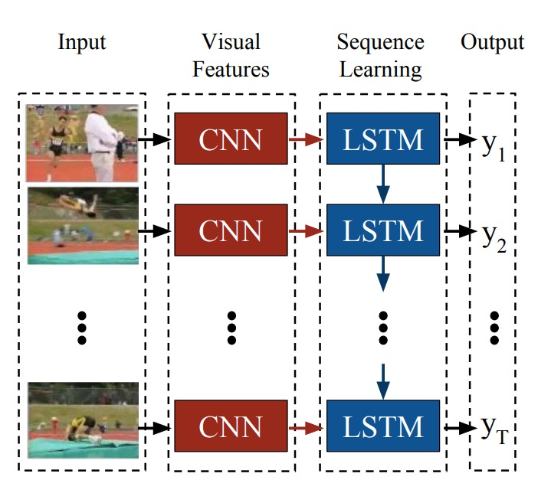
Proposed Solution
Step 3
Long Term Recurrent Convolutional Network (LRCN)

Slide 10
Results
Best Model parameters with using SMRF
Data: Training : 700 videos , each having 5 frames
Validation : 700 videos , each having 5 frames
Testing : 700 videos , each having 5 frames
Parameter | Value
2D convolution layer | 5
Max pooling layer | 5
LSTM units | 256
Optimizer | Adam
Dropout | 0.5
Epoch | 10
Batch size | 64
Train Accuracy: 99.29%
Validation Accuracy : 90%
Test Accuracy : 98%
Test Precision : 0.97
Test Recall : 0.97
Test F1 Score: 0.97

Slide 11
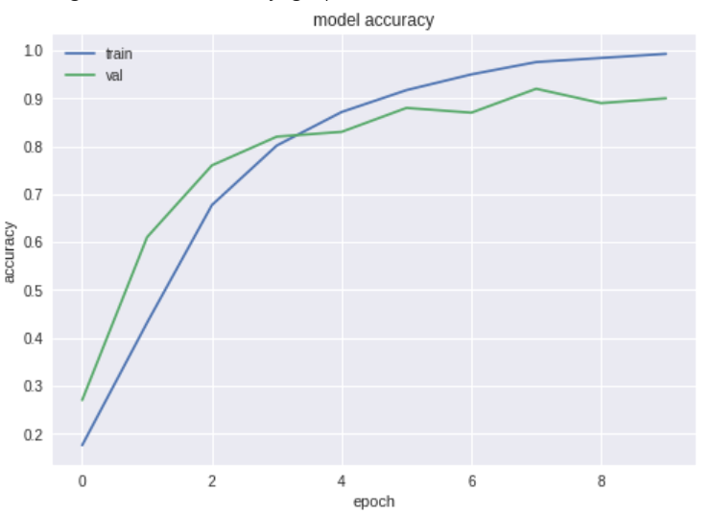
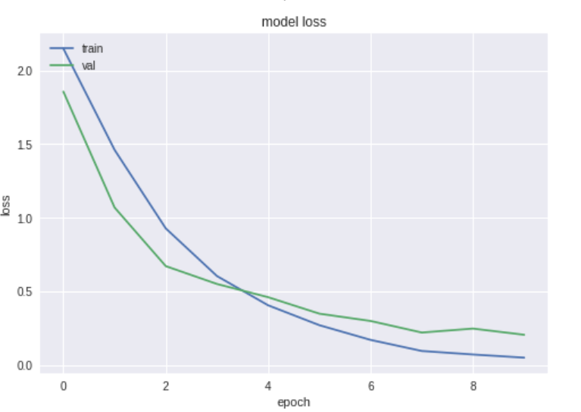
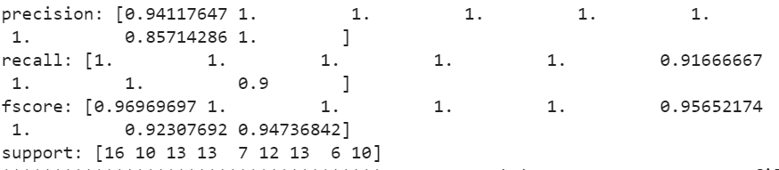
Results
Graphs:
Accuracy vs epoch loss vs epoch
Precision , Recall, f1 score, support:

Slide 12
Results
Best Model parameters without using SMRF
Data: Training : 700 videos , each having 5 frames
Validation : 700 videos , each having 5 frames
Testing : 700 videos , each having 5 frames
Parameter | Value
2D convolution layer | 5
Max pooling layer | 5
LSTM | 256
Optimizer | Adam
Dropout | 0.5
Epoch | 10
Batch size | 64
Train Accuracy: 90.12%
Validation Accuracy : 87.37%
Test Accuracy : 94.78%
Test Precision : 0.92
Test Recall : 0.93
Test F1 Score: 0.92

Slide 13
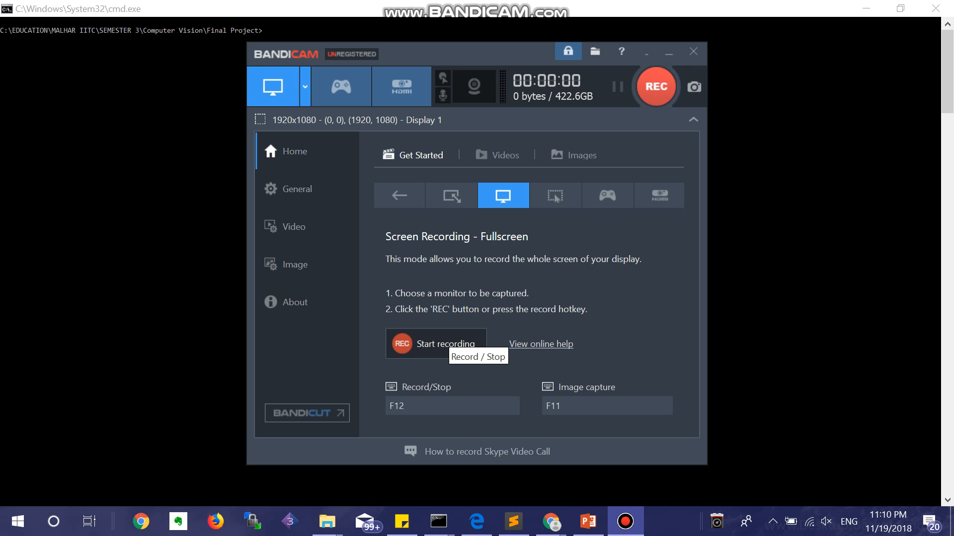
Results
Correct Classification example:

Slide 14
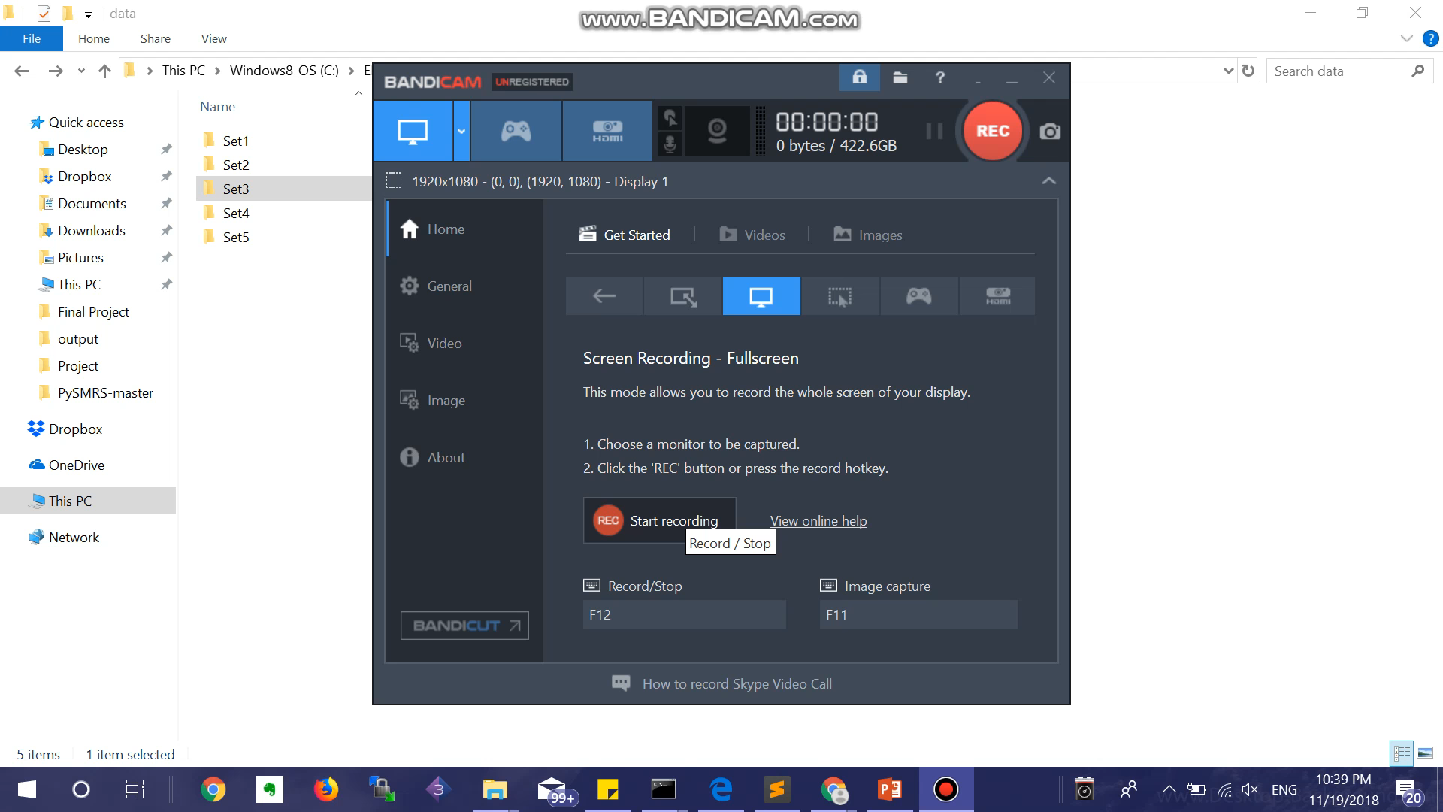
Results
Correct Classification example:

Slide 15
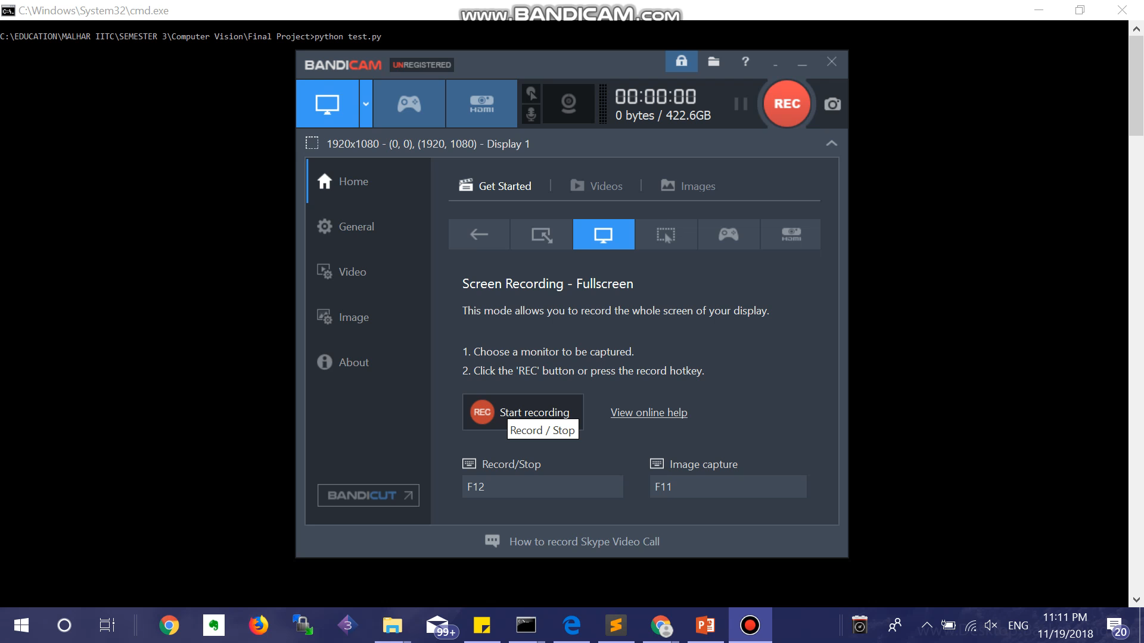
Results
Misclassification example:

Slide 16
Conclusion & Future Work
In this project, a Deep Learning based Hand Gesture Recognition algorithm is proposed for operating computer applications.
The Long term Recurrent Convolutional Neural Network is utilized to perform the hand gesture recognition.
The reasonable classiﬁcation accuracy and computational efﬁciency of the long term recurrent convolutional neural network is obtained by extracting 5 representative frames from the video sequence.
Our proposed algorithm is evaluated on the Cambridge public dataset.
In our future work, we will evaluate with a larger dataset containing flow images along with RGB images in order to improve the robustness of the system. With larger dataset pre-trained model such as VGG19, INCEPTION V3, etc will be used as CNNs.

Slide 17
References
Deep Learning-Based Fast Hand Gesture Recognition Using Representative Frames. Vijay John ; Ali Boyali ; Seiichi Mita ; Masayuki Imanishi ; Norio Sanma. 2016 International Conference on Digital Image Computing: Techniques and Applications (DICTA)
J. Donahue, L. A. Hendricks, S. Guadarrama, M. Rohrbach, S. Venugopalan, K. Saenko, and T. Darrell, “Long-term recurrent convolutional networks for visual recognition and description,” in CVPR, 2015.

Slide 18
Thank You!

